Slide 1

Machine Learning
Process Workflow
This Photo by Unknown Author is licensed under CC BY

Slide 2

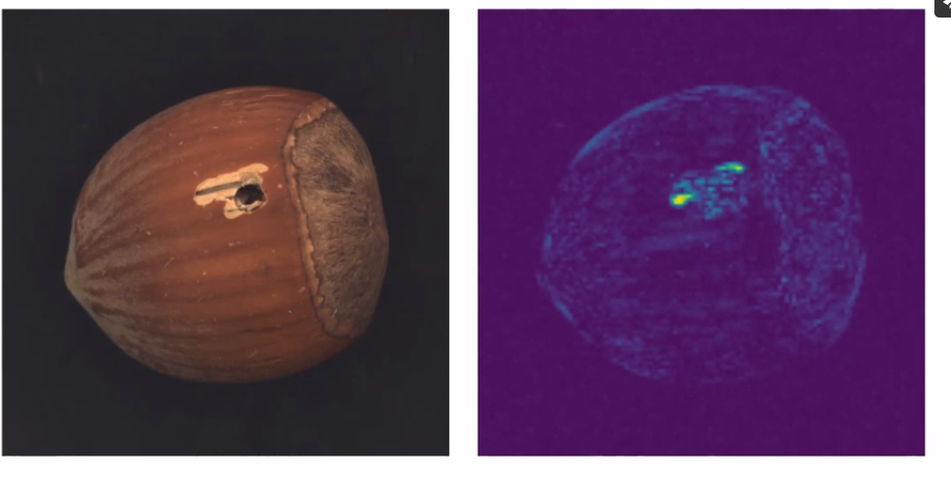
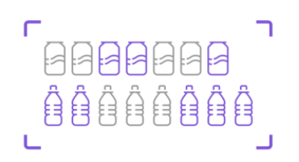
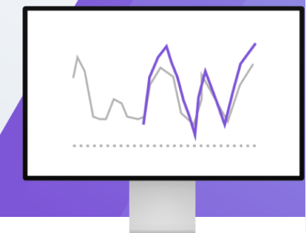
Machine Learning Applications
Virtual Assistant, Chat Bots
Anomaly Detection
Forecasting
Object Detection And Counting

Slide 3
What is Machine Learning ?
Machine Learning is the science (and art) of programming computers so they can learn from data
[Machine Learning is the] field of study that gives computers the ability to learn
without being explicitly programmed.
—Arthur Samuel, 1959
A computer program is said to learn from experience E with respect to some task T
and some performance measure P, if its performance on T, as measured by P, improves
with experience E.
—Tom Mitchell, 1997

Slide 4
Mathematical Model Analogy
x1
Model
Y
output/response
x2
Given input and output ; what is the model that best fits the data
Input/features
f(x) : hypothesis = weights * input + bias
We try to minimise the loss function/error to get best possible fit to the data by updating weight
Error : loss function = g(w)
minimize g(w) to find optimal weights

Slide 5
Data
Without data there is No “Machine Learning”
What is data – “ It can be any unprocessed fact, value, text, sound or picture that is not being interpreted and analyzed” ^{[1]}
Data
Information
Knowledge
Housing Prices in the city
Price Range :
$ 150K to $450K
Price depends on:
# of bedrooms
Distance from city centre
Ocean Vicinity etc.
Courtesy – [1]. analytics india magazine

Slide 6
Data Sources
Databases
Customer transaction data
Webservers
Customer click events on the website
Geolocations and weather centre data
Data collected in different labs
Observatories
NASA; European space agencies, ISRO collect data from space
Genomics
Data collected from DNA samples
Healthcare etc.
Patient health history

Slide 7
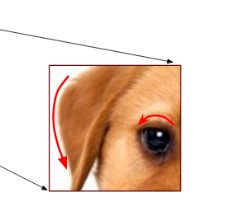
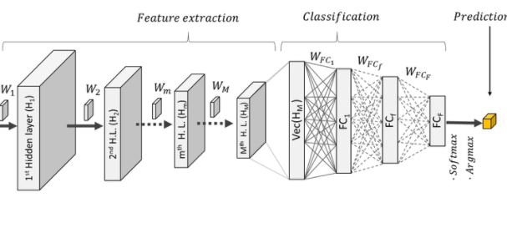
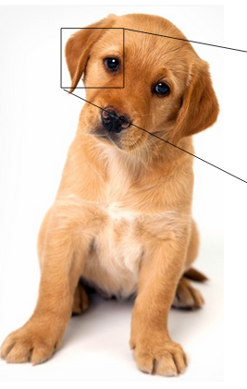
How Data Is Used In ML
Dog
Data
Features
Model
Prediction
text; images; audio; video
Text columns; part of the images
CNN,RNN
Classify document; identify object
NO Data → No business Insight
Useful data → Valuable Insight
Garbage In → Garbage Out

Slide 8
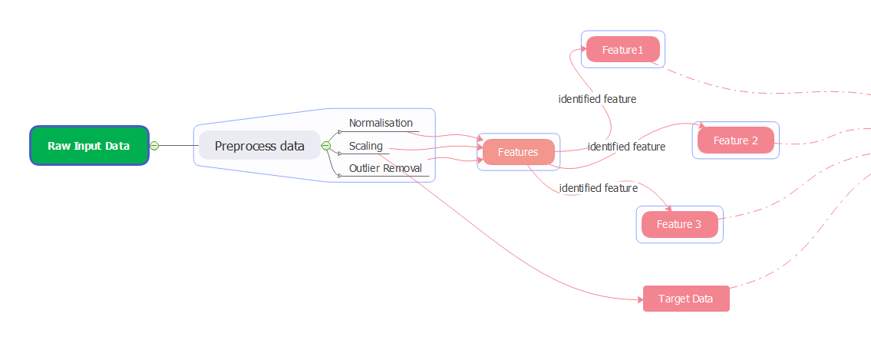
Data Pre-processing And Feature Selection
Identified features are fed to ML model
Clean and Transform
Feature Engineering and selection Phase
ML Model
Data extracted from different sources
Databases
Webservers
Surveys
Sensory data
Observatories

Slide 9
Feature Engineering And Feature Selection
Feature Engineering :
Feature engineering is the act of extracting features from raw data and transforming them into formats that are suitable for the machine learning Model
Feature Selection:
Feature selection techniques prune away non useful features in order to reduce the complexity of the resulting model
Selecting inputs which are more suitable for model and results in better model
Reducing feature does not necessarily reduce training time
Data
Features
Model
Prediction

Slide 10
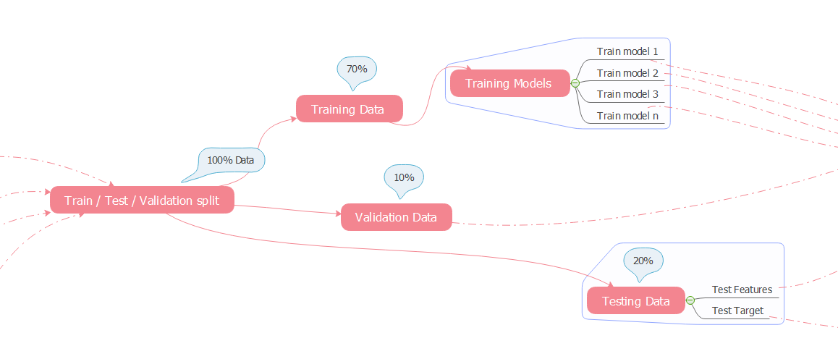
Train/Test /Validation Split
Data is divided into three parts training, validation and testing
Training Set - This part of data is used for training purpose
Validation Set – This is also called as hold out set; it is used for model selection. Different models are evaluated on validation set
Test Set – This data is not used during training; final model is evaluated using test set

Slide 11

Model Training [Finding Model Parameters]

Slide 12
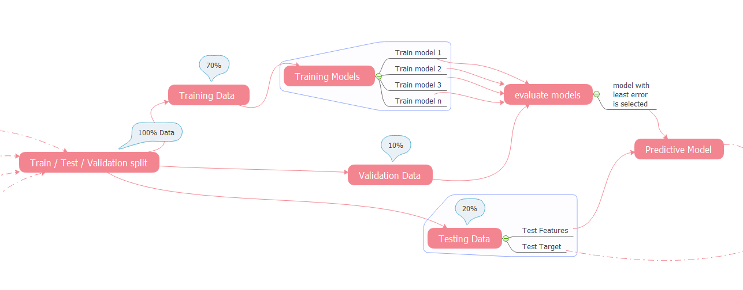
Model Evaluation [Selecting A Model]

Slide 13
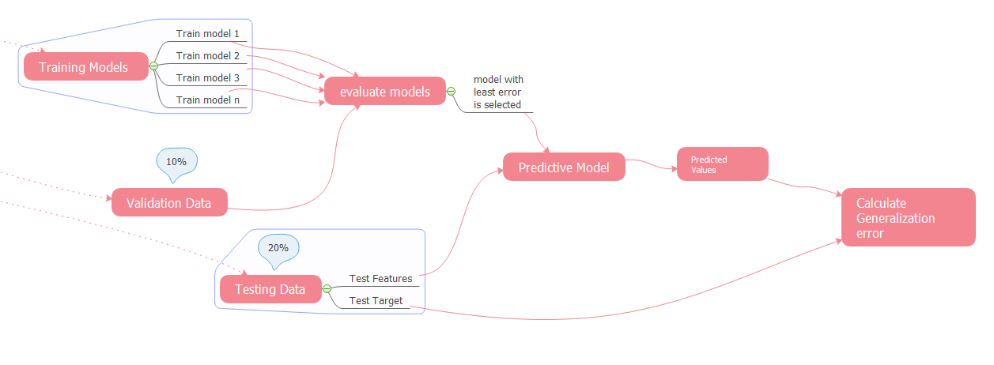
Model Prediction And Generalization (Overfit/Underfit)

Slide 14
MODEL DEMO

Slide 15
What We Learnt Today
What is machine learning
Analogy to Mathematical model
What is Data and how its used to train machine learning models
Machine Learning process workflow
Demo on model parameter and hyperparameter
Underfitting and Overfitting
Model Generalisation

Slide 16
THANK YOU!

